Slide 1
G. H. RAISONI COLLEGE OF ENGG. & MANAGEMENT Gat No. 1200, Wagholi, Pune – 412 207
(An Autonomous Institute Affiliated to Savitribai Phule Pune University)
Session 2020-21
Presentation on
“MATLAB Program to Print Matrix of Addition”
(Add Two 3 by 3 Matrices)
By
C69 - SUSHMA DIPAK YEMMEWAR
C70 - SWAYAM PRAMOD TERODE
C71 - TANMAY RADHAKRISHNA ASWALE
C72 - VALLABH RAJARAM SHRIMANGALE
Faculty Name: Prof. Moienahmad Borotikar
FY B.Tech: Division C

Slide 2
What is Matlab?
MATLAB (an abbreviation of "matrix laboratory") is a proprietary multi-paradigm programming language and numeric computing environment developed by Math Works. MATLAB allows matrix manipulations, plotting of functions and data, implementation of algorithms, creation of user interfaces, and interfacing with programs written in other languages.
Although MATLAB is intended primarily for numeric computing, an optional toolbox uses the MuPAD symbolic engine allowing access to symbolic computing abilities. An additional package, Simulink, adds graphical multi-domain simulation and model-based design for dynamic and embedded systems.
As of 2020, MATLAB has more than 4 million users worldwide. MATLAB users come from various backgrounds of engineering, science, and economics.

Slide 3
Matlab Applications
Design, simulate, and test automated driving systems.
Develop and deploy condition monitoring and predictive maintenance software.
Design, simulate, and verify robotics and autonomous systems.
Data preparation, design, simulation, and deployment for deep neural networks.
Analyze, design, and verify analogy and mixed-signal systems.
Design and implement digital control for motors, power converters, and battery systems.
Automate your workflow — from algorithm development to hardware design and verification.
Acquire, analyze, and explore data and automate tests.
Data preparation, design, simulation, and deployment for deep neural networks.

Slide 4

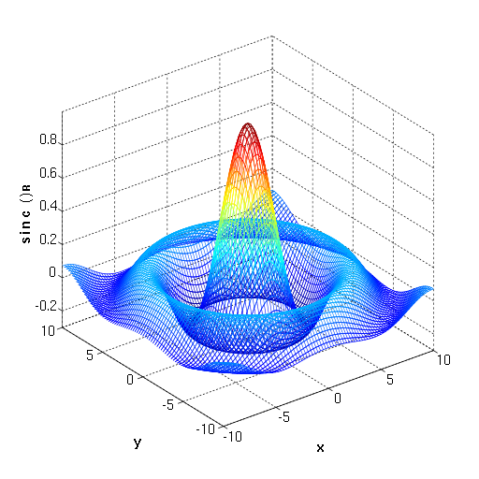
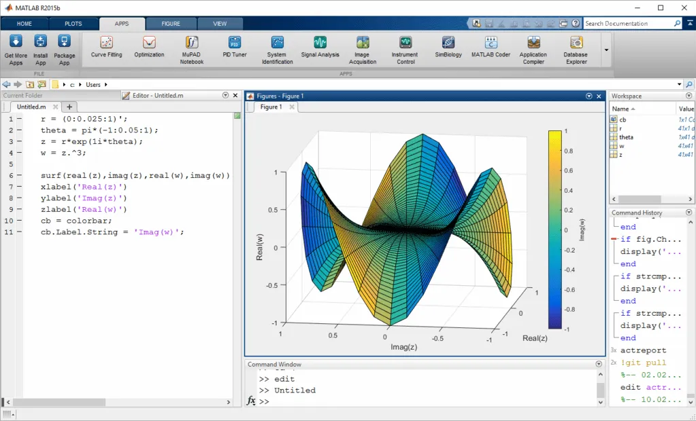
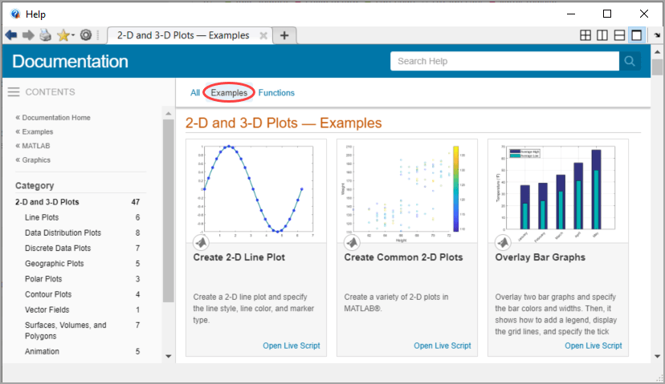
Matlab Logo, Graphs &Documentation images

Slide 5
Syntax of Matlab
There are two types of syntax in matlab:
Function syntax :- “function [y1,...,yN] = myfun(x1,...,xM)”
function [y1,...,yN] = myfun(x1,...,xM) declares a function named myfun that accepts inputs x1,...,xM and returns outputs y1,...,yN. This declaration statement must be the first executable line of the function. Valid function names begin with an alphabetic character, and can contain letters, numbers, or underscores.
You can save your function:
In a function file which contains only function definitions. The name of the file must . match the name of the first function in the file.
In a script file which contains commands and function definitions. Functions must be . at the end of the file. Script files cannot have the same name as a function in the file. . Functions are supported in scripts in R2016b or later.

Slide 6
2. Command :- “load durer.mat % Command syntax”
With command syntax, MATLAB passes all inputs as character vectors (that is, as if they were enclosed in single quotation marks) and does not assign outputs to variables. To pass a data type other than a character vector, use the function syntax. To pass a value that contains a space, you have two options. One is to use function syntax. The other is to put single quotes around the value. Otherwise, MATLAB treats the space as splitting your value into multiple inputs.
Command syntax always passes inputs as character vectors and cannot pass variable values. For example, create a variable and call the disp function with function syntax to pass the value of the variable:
A = 123; disp(A)
This code returns the expected result,
123
You cannot use command syntax to pass the value of A, because this call
disp A
is equivalent to disp('A')
and returns
A

Slide 7
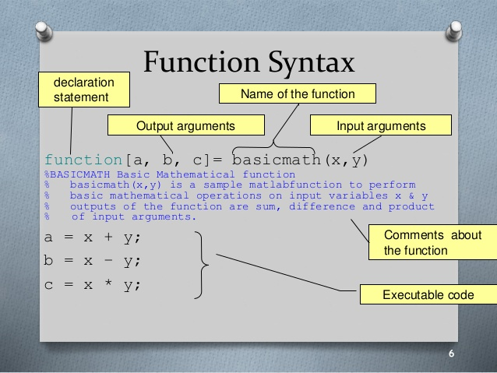
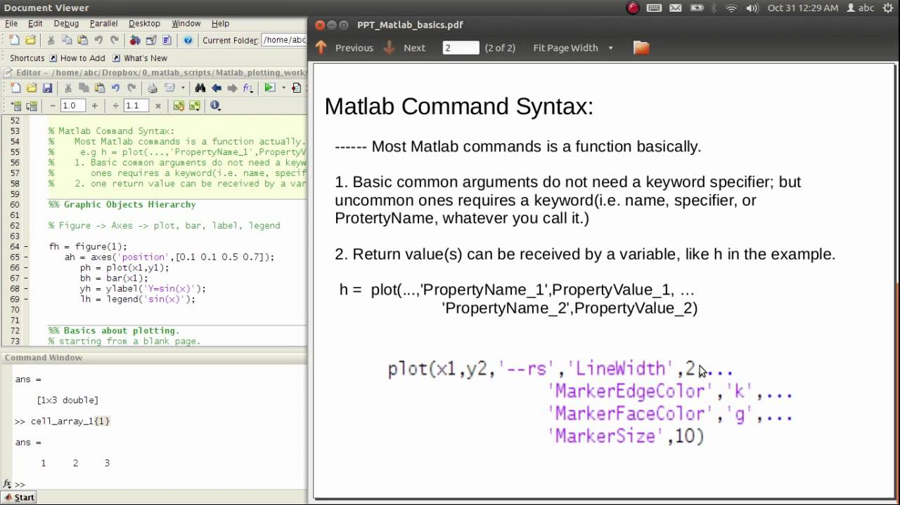

Slide 8
Addition of Two matrix
Let matrix A =[ 3 4 5; 7 9 3; 8 1 2 ]
And matrix B =[ 7 6 5; 3 1 7; 2 9 8 ]
Input program
clc
clear all
close all
A=[3 4 5; 7 9 3; 8 1 2]
B=[7 6 5; 3 1 7; 2 9 8]
C=A+B

Slide 9
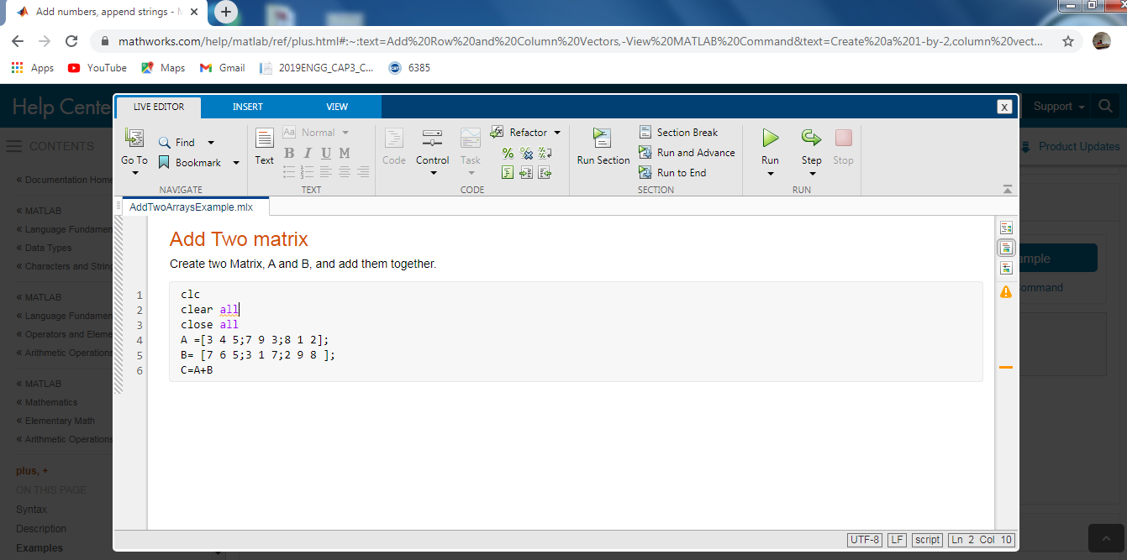
Input of 2 matrix (3 by 3 matrix)

Slide 10
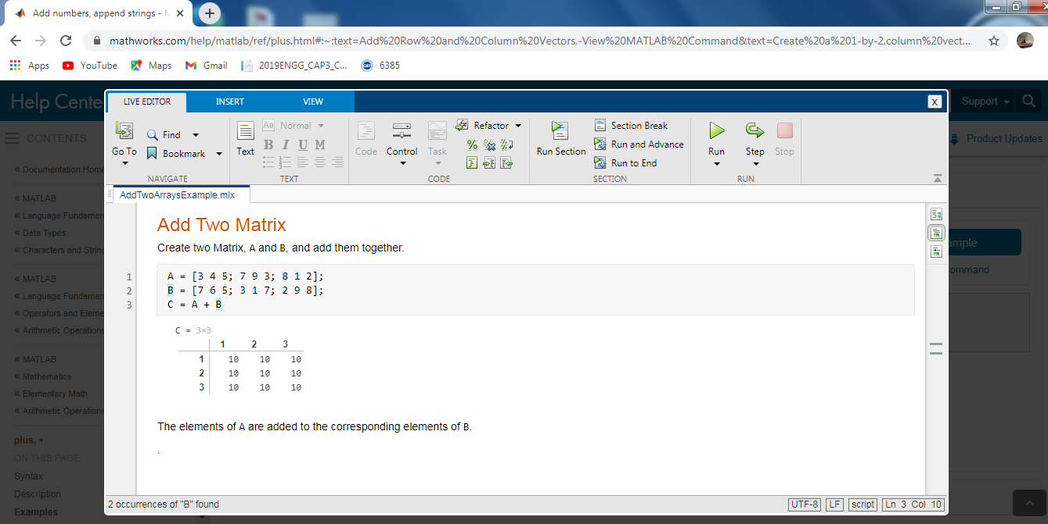
Output
C=[10 10 10; 10 10 10; 10 10 10]

Slide 11
Thank You

